Slide 1
Bivariate Regression
Presented By:
Chandra Prakash
Guneet Singh Bajaj
Hemlata Saraswat

Slide 2
Objective:
Our objectives is to find the relationship between the home runs and the batting average of a baseball player.

Slide 3


TOOLS USED
1. Programming Language :- R
2. Libraries :- ggplot2, caTools, Publish
3.IDE :- RStudio

Slide 4
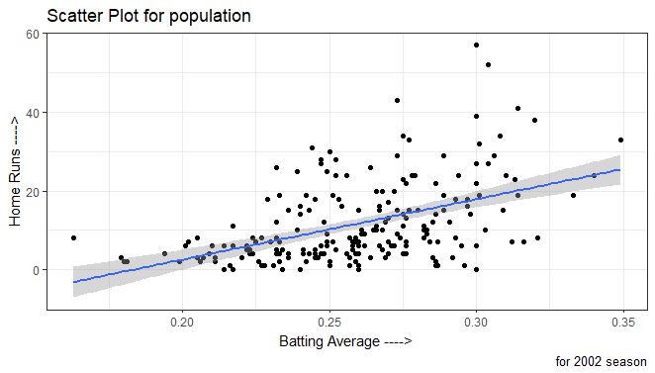
1. Scatter Plot

Slide 5
Evidence for relationship and Variability
Yes, there is a positive linear relationship.
The variability of number of home runs is greater for those with higher batting averages.

Slide 6
Regression model
Bivariate Regression –
Applying Regression on homerun versus battion Average
Intercept is :-
Slope :-

Slide 7
Visualization

Slide 8
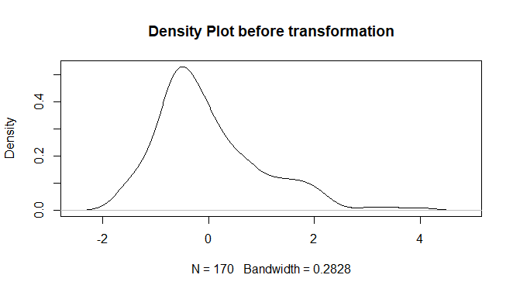
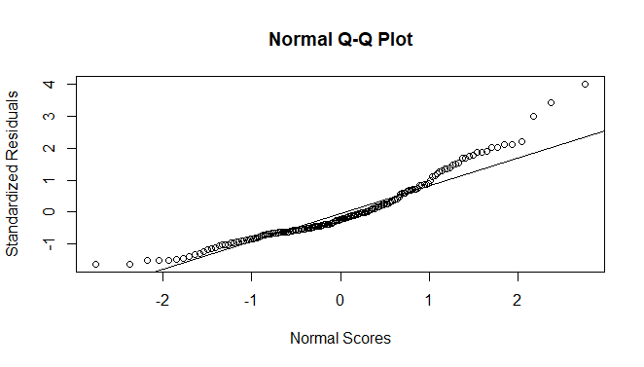
Skewness and Normality

Slide 9
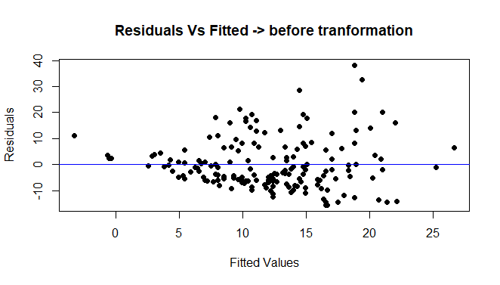
Fitted vs Residuals

Slide 10
Regression Model After Transformation
After taking log of response variable i.e. Homeruns
Applying regression on log of Homeruns versus Batting Average

Slide 11
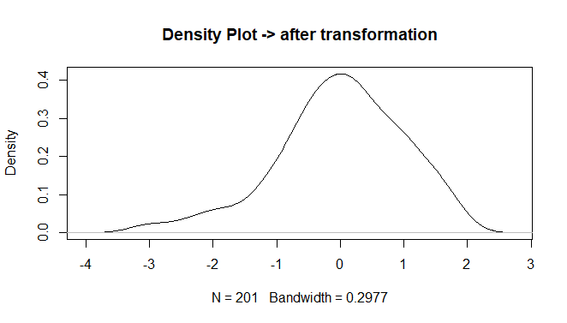
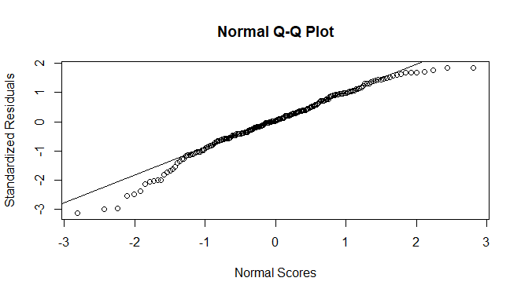
Skewness and Normality after transformation

Slide 12
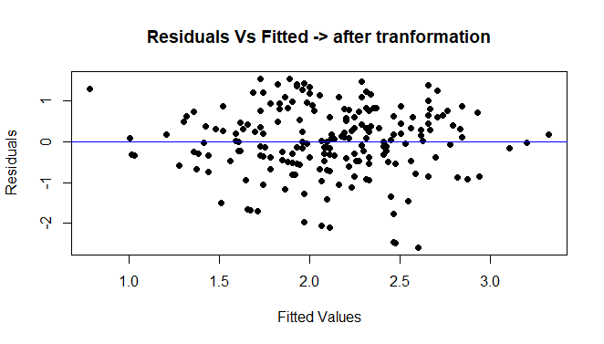
Fitted vs Residuals after transformation

Slide 13
Equation of population regression
Recall equations of line :
Algebra Line: y = mx + c
Statistics Line: y = 𝛃o + 𝛃1x , where
𝛃o = y-intercept ⇒ -28.149
𝛃1 = slope of the line ⇒ 153.551
R square = 0.2305

Slide 14
Equation of regression on sample
Statistics Line: y = bo + b1x , where
bo = y-intercept ⇒ -1.4346
b1 = slope of the line ⇒ 13.6375
R square = 0.2189

Slide 15
Estimation of homerun with batting average of 0.300 :-
Fdb
Size of typical error in prediction :-
Wjefb
Percentage of variability in model:-
vjbev

Slide 16
Hypothesis test for linear relationship
Null hypothesis – There is no linear relationship between homeruns and batting average.
Alternate Hypothesis – there is linear relationship between homeruns and batting average.

Slide 17
Corelation
whvw

Slide 18
95% confidence interval for the unknown true slope of the regression line.
Vnsbd
95% confidence interval for the population correlation coefficient.
Djbcs
95% confidence interval for the mean number of home runs for all players who had a batting average of 0.300.
dvcwh

Slide 19
95% confidence interval for a randomly chosen player with a 0.300 batting average.
Sdvhb
outlier

